Slide 1
Lidar Project Feedback Same team in Following Assignments

Slide 2
Camera Image processing

Slide 3
Lidar-Camera Fusion Block Diagram
Bounding Box with PCD
Lidar PCD
Filtering
Segmentation
Clustering
PCD Projection on Camera
Camera-lidar Fusion
Tracked ObjectList Class, Id Location(x,y,z) Velocity and Acc (Vx, Vy, Ax, Ay)
Features Extraction/Tracking
Objects Tracking
Bounding Boxes with Classes and Ids
Images
Image Processing
Objects Detection & Recognition

Slide 4
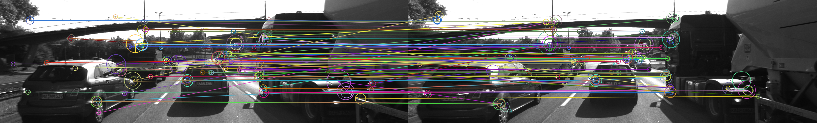
Image Features Tracking Block Diagram
Images
Feature Extraction
Feature Tracking
Image Processing
Application: Time To Collision Calculation Using Camera

Slide 5

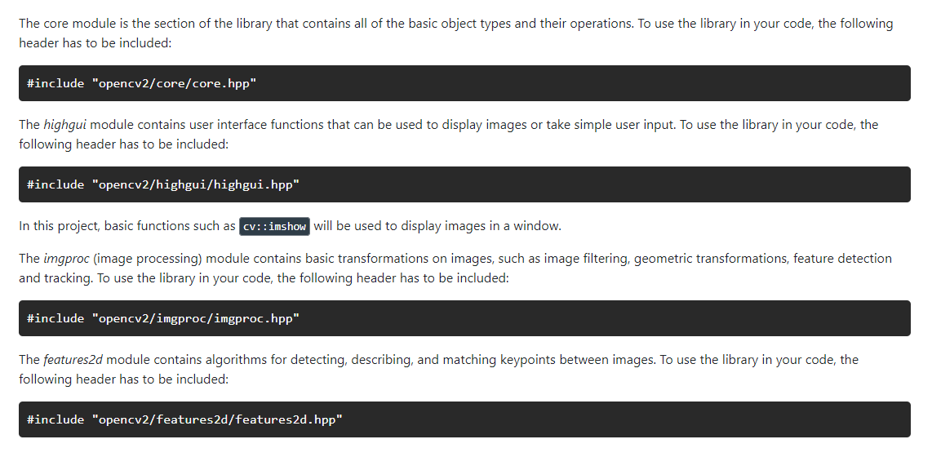
OpenCV using C++

Slide 6
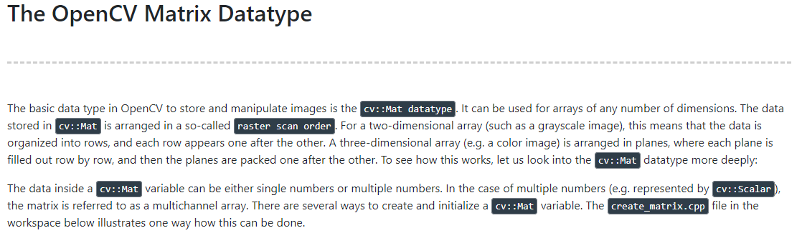
CODE:
create_matrix.cpp
change_pixels.cpp
load_image_3.cpp

Slide 7
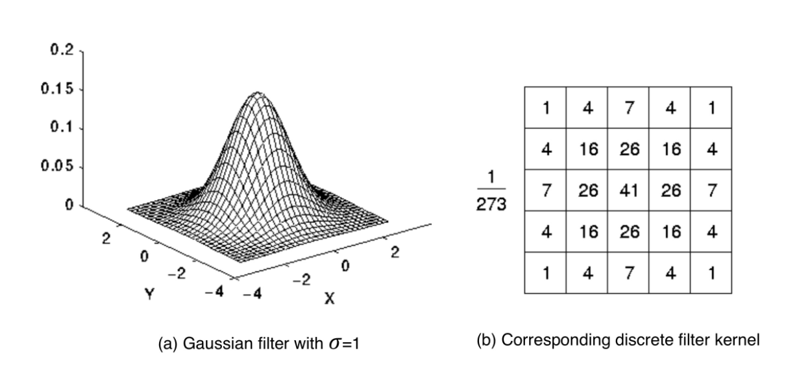
0.Image Filters and Gaussian Smoothing [LPF]
Used for noise Reduction

Slide 8
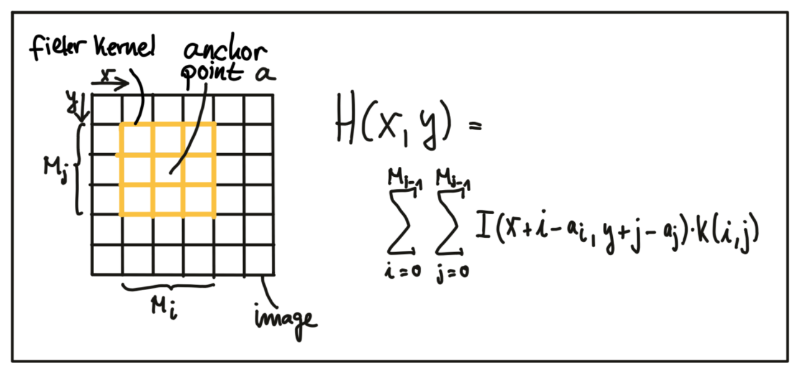
0.Image Filters and Gaussian Smoothing

Slide 9
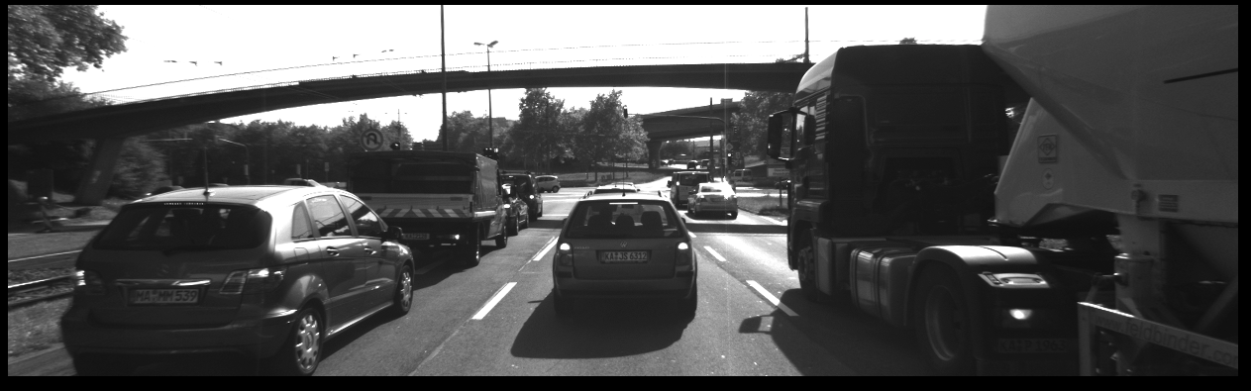
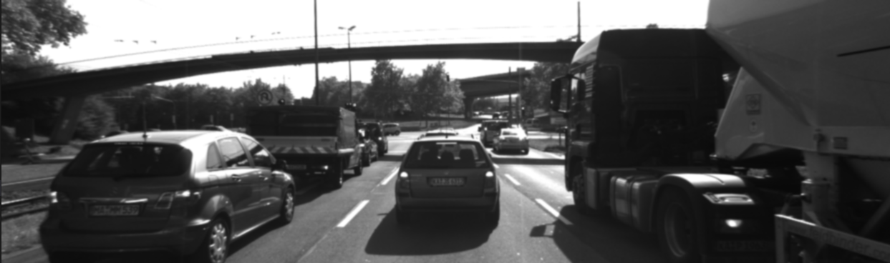
Code gaussian_smoothing.cpp
Results:

Slide 10
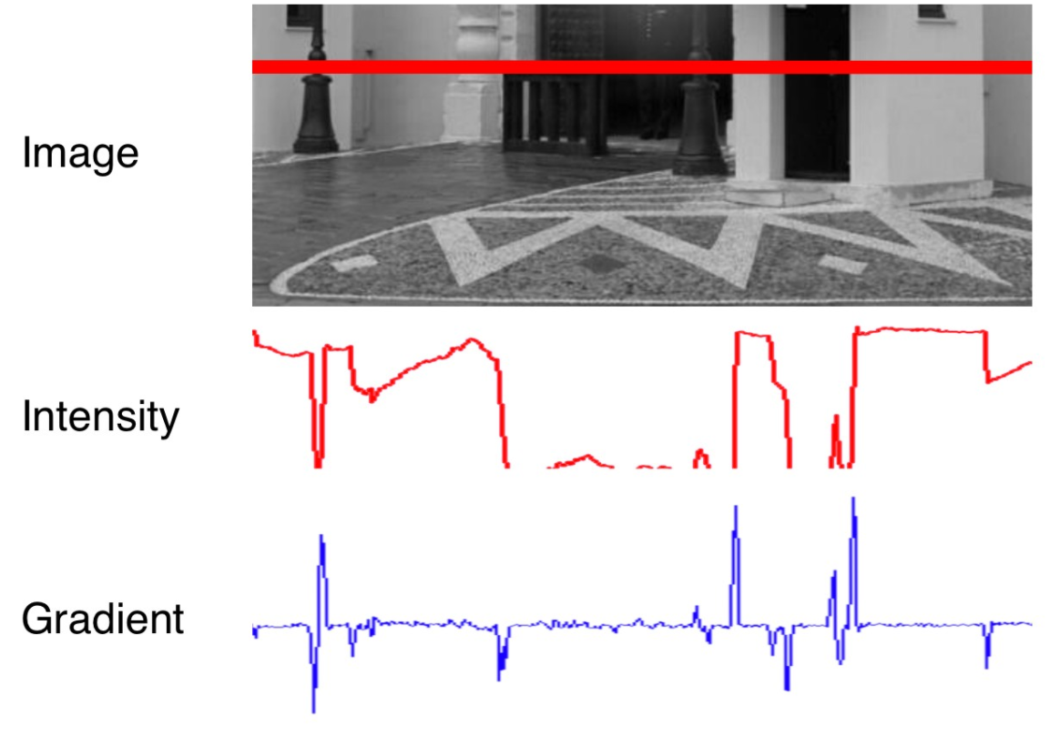
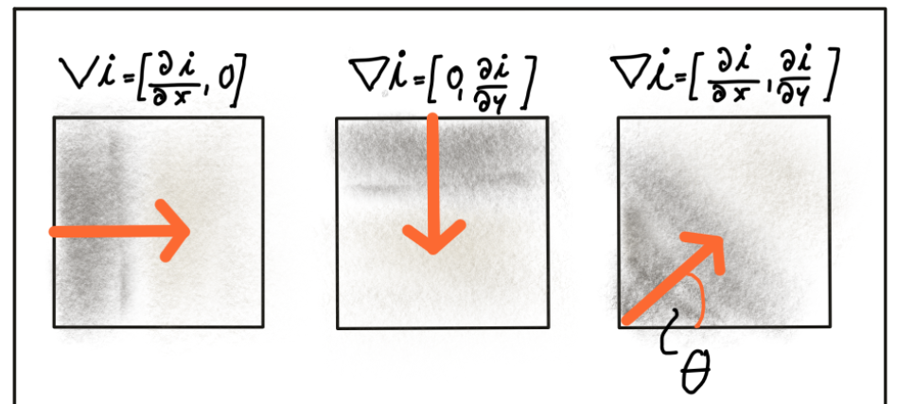
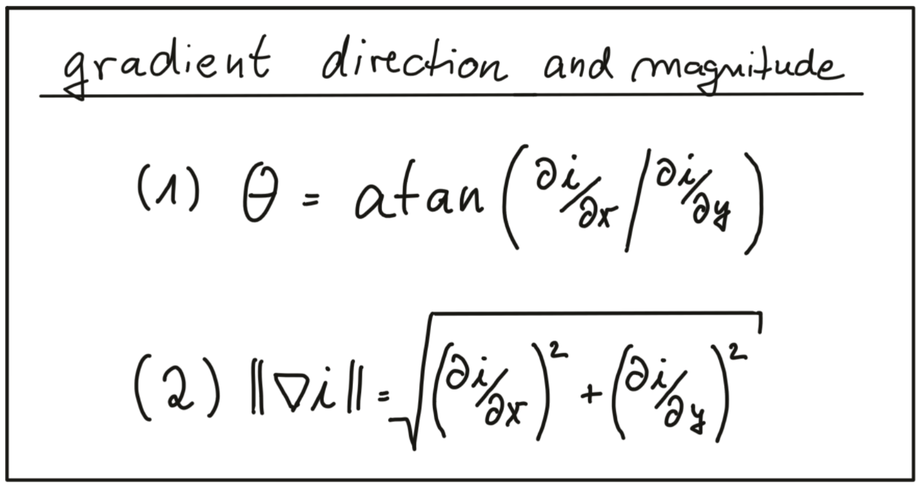
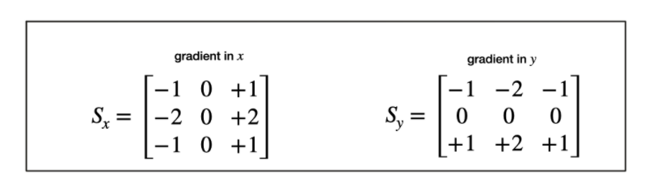
01. Intensity Gradient and Filtering[High Pass Filter]

Slide 11
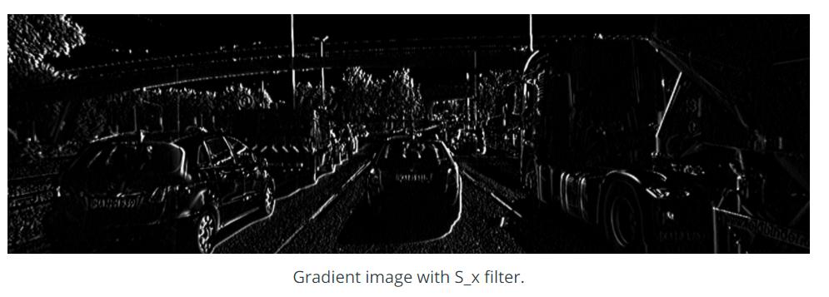
01. Intensity Gradient and Filtering
Code magnitude_sobel.cpp

Slide 12
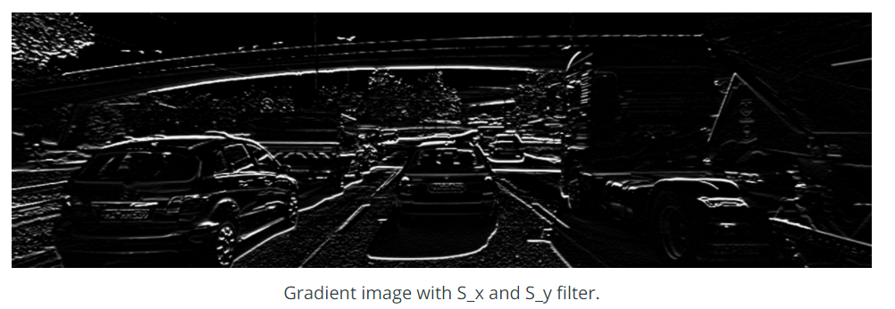
01. Intensity Gradient and Filtering

Slide 13
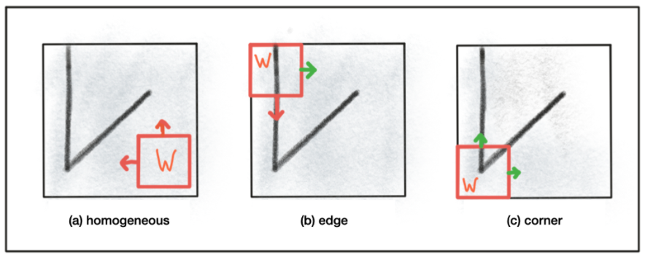
02. Harris Corner Detection [Smoothing + gradient + Smoothing]
A red arrow indicates that no unique position can be found in this direction. The green arrow expresses the opposite. As can be seen, the corner is the only local structure that can be assigned a unique coordinate in x and y.
Generally, a suitable measure for describing change mathematically is the sum of squared differences (SSD), which looks at the deviations of all pixels in a local neighborhood before and after performing a coordinate shift.
In order to locate a corner, we consider how the content of the window would change when shifting it by a small amount. For case (a) in the figure above, there is no measurable change in any coordinate direction at the current location of the red window W whereas for (b), there will be significant change into the direction orthogonal to the edge and no change when moving into the direction of the edge. In case of (c), the window content will change in any coordinate direction.

Slide 14
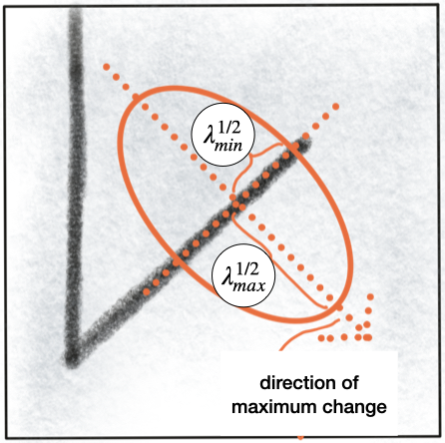
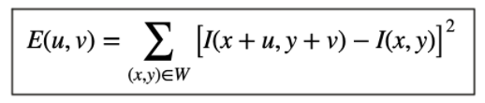
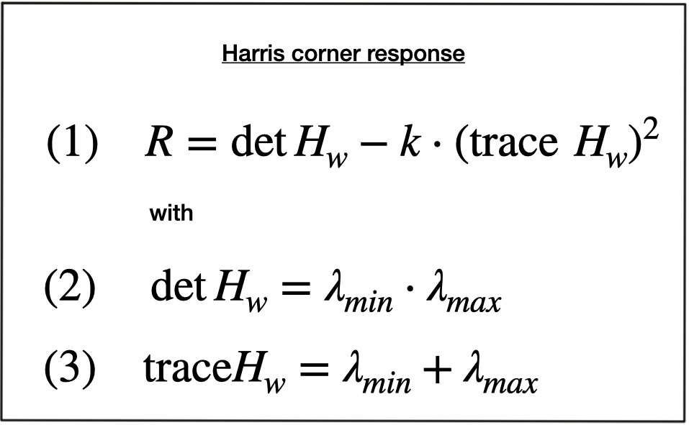
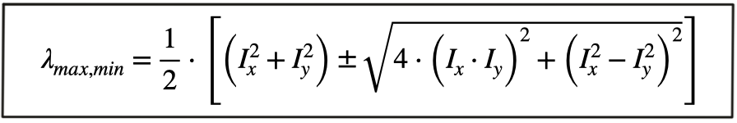
02. Harris Corner Detection
Shift the Window W by an amount u in x-direction and v in y-direction
The equation sums up the squared differences of all pixels within W at the old and at the new window position.
In addition to the smoothing of the image before gradient computation, the Harris detector uses a Gaussian window w(x,y) to compute a weighted sum of the intensity gradients around a local neighborhood.

Slide 15
Code cornerness_harris.cpp

Slide 16
02. Haris Corner Detection
Non Maximum Suppression
The idea is to reduce the intensities (e.g. corner response) in a local neighborhood in such a way that only the strongest response remains.
Define the size of the local neighborhood (i.e. a sliding window).
Loop over all rows and cols of the input image.
Center the sliding window on the current location and search for the maximum response value.
If the current pixel is identical to the max. response value, then push it in keypoints list. Otherwise, do nothing.
Once all pixels have been processed, only the strongest responses will remain.

Slide 17
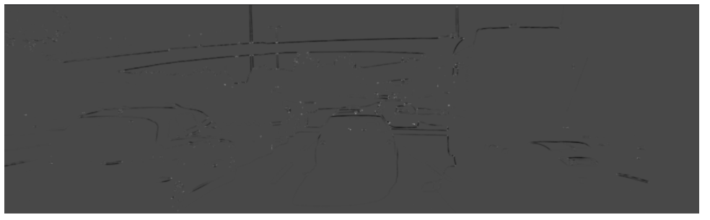
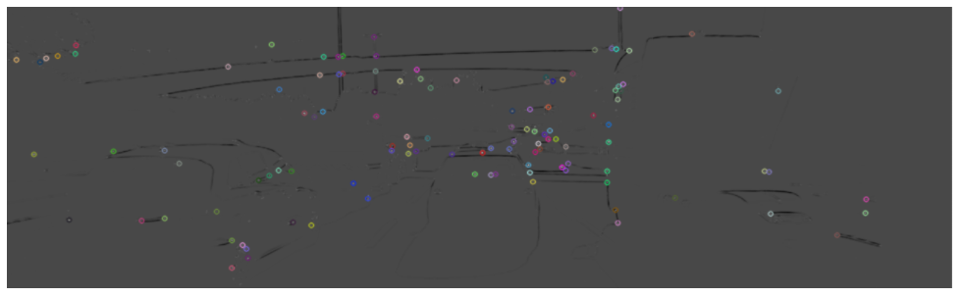
02. Haris Corner Detection
Harris Corner Detection result
Non Maximum Suppression

Slide 18
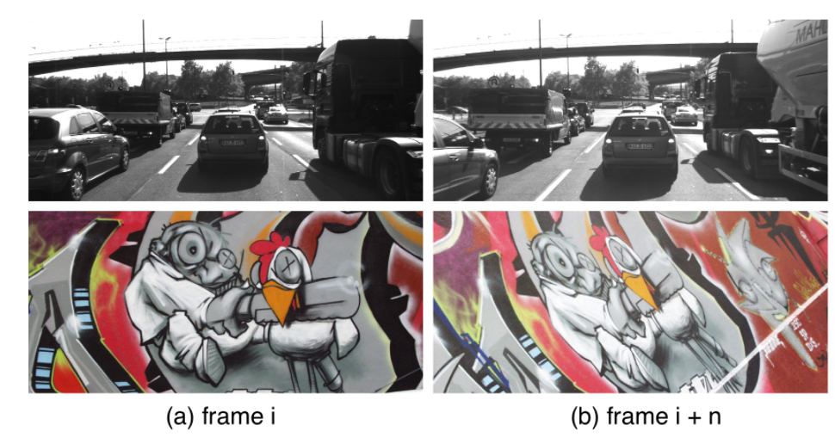
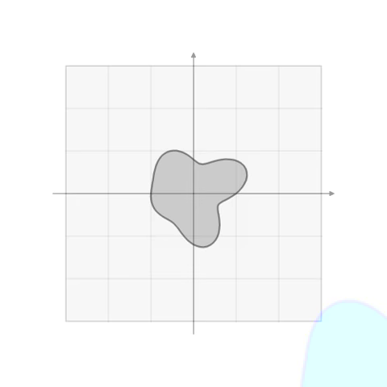
03. Overview of Popular Keypoint Detectors
Invariance to Photometric and Geometric Changes
Rotation
Scale change
Intensity change
Affine transformation

Slide 19
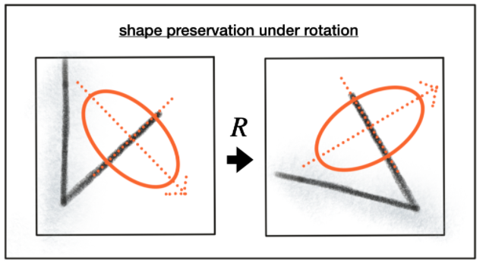
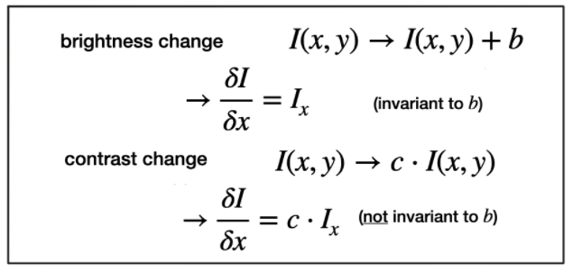
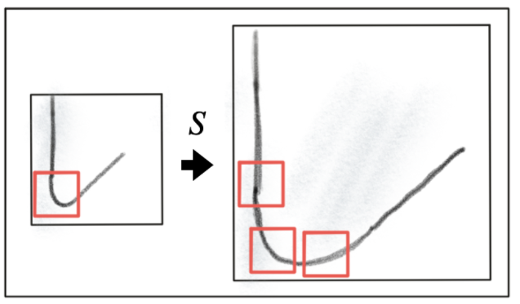
03. Overview of Popular Keypoint Detectors
Rotation R :
Scale change:
Intensity change:

Slide 20
03. Overview of Popular Keypoint Detectors
The Harris detector is robust under rotation and additive intensity shifts, but sensitive to scale change, multiplicative intensity shifts (i.e. changes in contrast) and affine transformations.
Popular classic detectors:
1988 Harris Corner Detector (Harris, Stephens)
1996 Good Features to Track (Shi, Tomasi)
2006 Features from Accelerated Segment Test (FAST) (Rosten, Drummond)
2010 Binary Robust Independent Elementary Features (BRIEF) (Calonder, et al.)
2011 Oriented FAST and Rotated BRIEF (ORB) (Rublee et al.)
2011 Binary Robust Invariant Scalable Keypoints (BRISK) (Leutenegger, Chli, Siegwart)
2012 Fast Retina Keypoint (FREAK) (Alahi, Ortiz, Vandergheynst)
2012 KAZE (Alcantarilla, Bartoli, Davidson)

Slide 21
Code detect_keypoints.cpp Use the OpenCV library to add the FAST detector in addition to the already implemented Shi-Tomasi detector and compare both algorithms with regard to (a) number of keypoints, (b) distribution of keypoints over the image and (c) processing speed. Describe your observations with a special focus on the preceding vehicle.

Slide 22
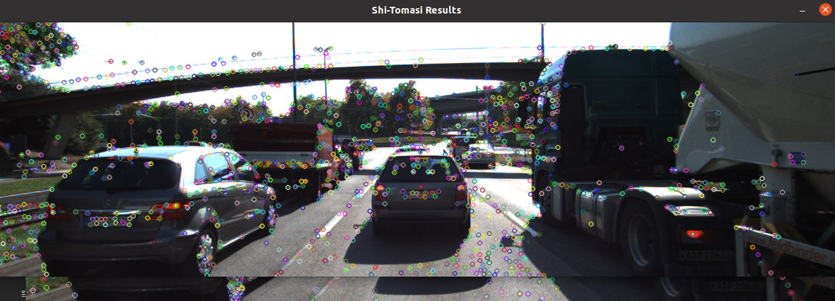
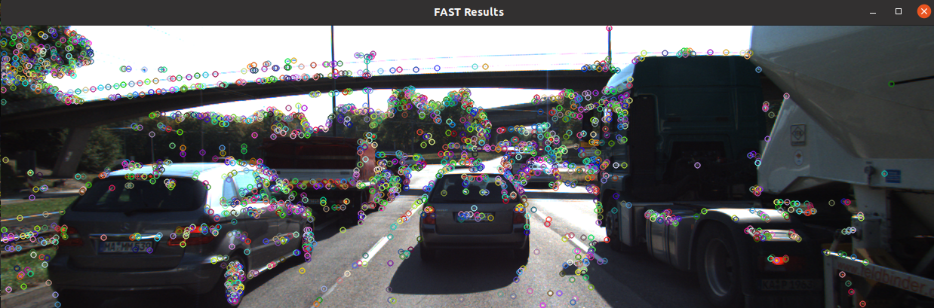
Code detect_keypoints.cpp results:
Shi-Tomasi with n= 1144 keypoints in 19.5744 ms
FAST with n= 1864 keypoints in 0.591896 ms

Slide 23
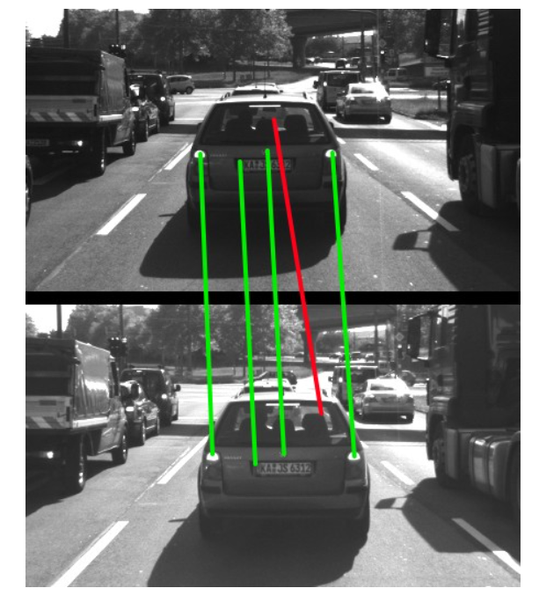
04. Gradient-based vs. Binary Descriptors
A keypoint detector is an algorithm that chooses points from an image based on a local maximum of a function, such as the "cornerness" metric we saw with the Harris detector. Keypoints are sometimes referred to as interest points or salient points.
A descriptor is a vector of values, which describes the image patch around a keypoint. There are various techniques ranging from comparing raw pixel values to much more sophisticated approaches such as histograms of gradient orientations.
Descriptors help us to assign similar keypoints in different images to each other. As shown in the figure below, a set of keypoints in one frame is assigned keypoints in another frame such that the similarity of their respective descriptors is maximized and (ideally) the keypoints represent the same object in the image. In addition to maximizing similarity, a good descriptor should also be able to minimize the number of mismatches, i.e. avoid assigning keypoints to each other that do not correspond to the same object.

Slide 24
04. Gradient-based vs. Binary Descriptors
The Harris detector along with several other "classics" belongs to a group of traditional detectors, which aim at maximizing detection accuracy. In this group, computational complexity is not a primary concern. The following list shows a number of popular classic detectors :
1988 Harris Corner Detector (Harris, Stephens)
1996 Good Features to Track (Shi, Tomasi)
1999 Scale Invariant Feature Transform (Lowe)
2006 Speeded Up Robust Features (Bay, Tuytelaars, Van Gool)
In recent years, a number of faster detectors have been developed which aim at real-time applications on smartphones and other portable devices. The following list shows the most popular detectors belonging to this group:
2006 Features from Accelerated Segment Test (FAST) (Rosten, Drummond)
2010 Binary Robust Independent Elementary Features (BRIEF) (Calonder, et al.)
2011 Oriented FAST and Rotated BRIEF (ORB) (Rublee et al.)
2011 Binary Robust Invariant Scalable Keypoints (BRISK) (Leutenegger, Chli, Siegwart)
2012 Fast Retina Keypoint (FREAK) (Alahi, Ortiz, Vandergheynst)
2012 KAZE (Alcantarilla, Bartoli, Davidson)

Slide 25
04. Gradient-based vs. Binary Descriptors
Descriptors
Gradient-based
Binary-based
(BRIEF)
Histogram of Gradients[HOG]
(FREAK)
(BRISK)
(ORB)
(SIFT)
(SURF)
(KAZE)

Slide 26
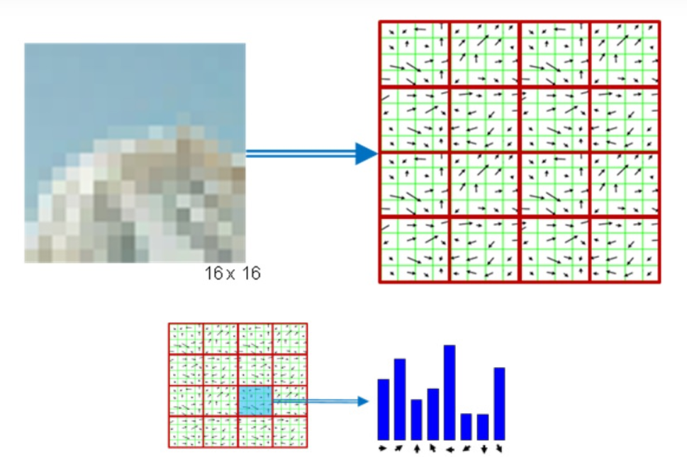
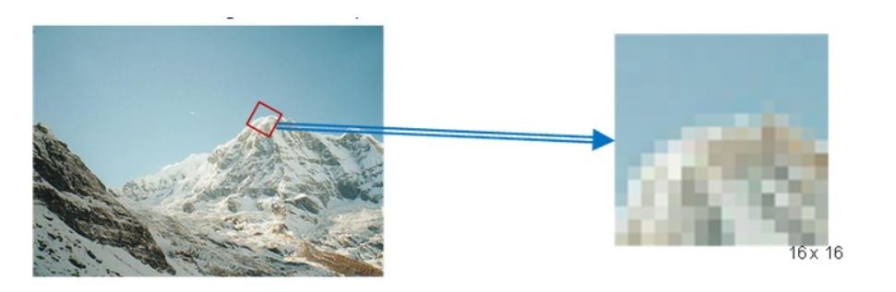
04. Gradient-based vs. Binary Descriptors
Histogram of Gradients[HOG]
(SIFT)

Slide 27
04. Gradient-based vs. Binary Descriptors
Descriptors
The central idea of binary descriptors is to rely solely on the
Intensity information (i.e. the image itself) and
To encode the information around a keypoint in a string of binary numbers, which can be compared very efficiently in the matching step when corresponding keypoints are searched.
Binary-based
(BRIEF)
(FREAK)
(BRISK)
(ORB)
(KAZE)

Slide 28
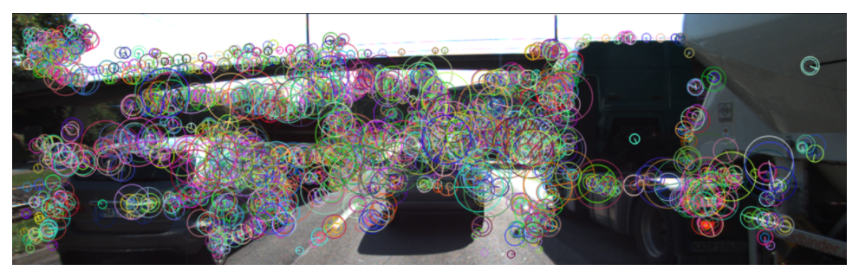
Code describe_keypoints.cpp
For the BRISK detector, the keypoints can be seen in the following figure with the center of a circle denoting its location and the size of the circle reflecting the characteristic scale.
BRISK detector with n= 2896 keypoints in 66.474 ms
BRISK descriptor in 45.7431 ms
Descriptor image

Slide 29
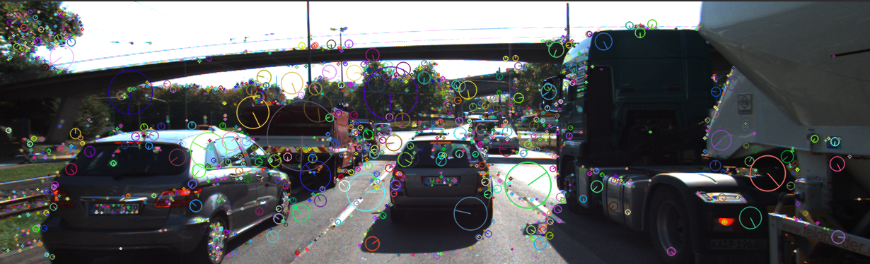
Code describe_keypoints.cpp
SIFT :
SIFT descriptor in 28.7627 ms
desc.size = 1819 x 64
kpts.size = 1819

Slide 30
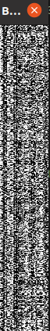
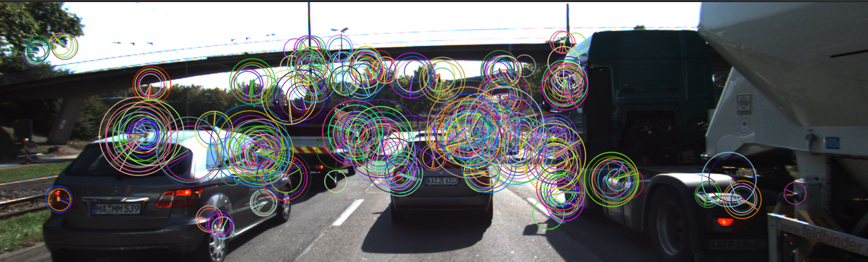
Code describe_keypoints.cpp
ORB:
ORB descriptor in 6.00633 ms
desc.size = 391 x 64
kpts.size = 391
Descriptor image

Slide 31
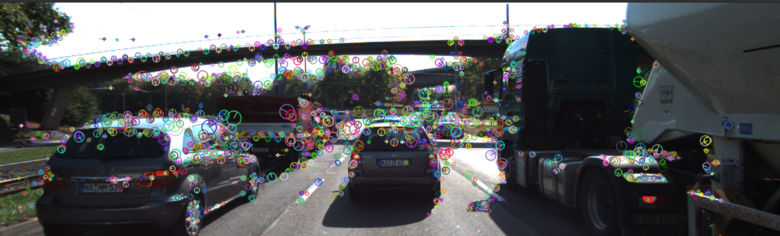
Code describe_keypoints.cpp
AKAZE :
AKAZE descriptor in 25.9619 ms
desc.size = 1513 x 64
kpts.size = 1513

Slide 32
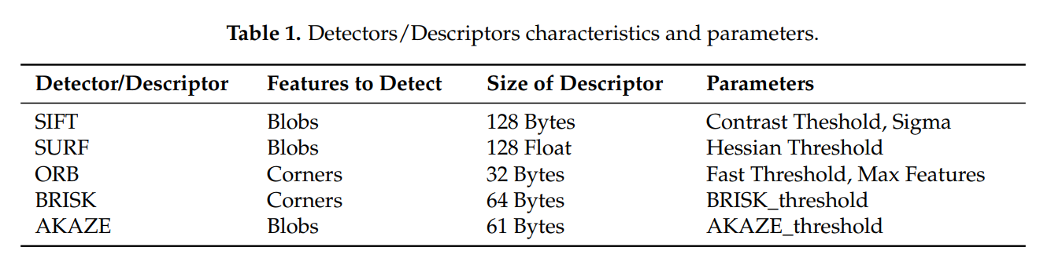
Code describe_keypoints.cpp
Source: https://www.mdpi.com/1424-8220/20/15/4343/pdf

Slide 33
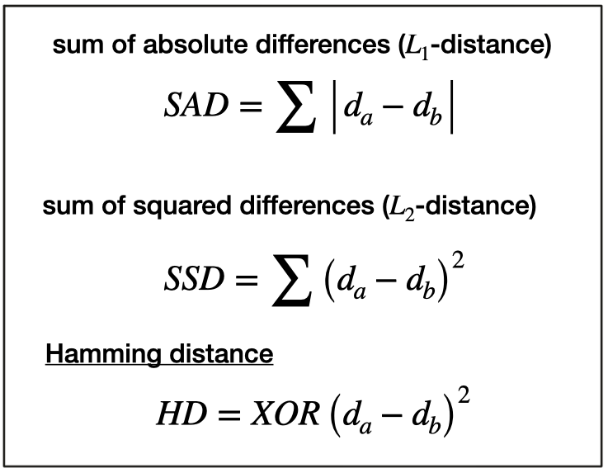
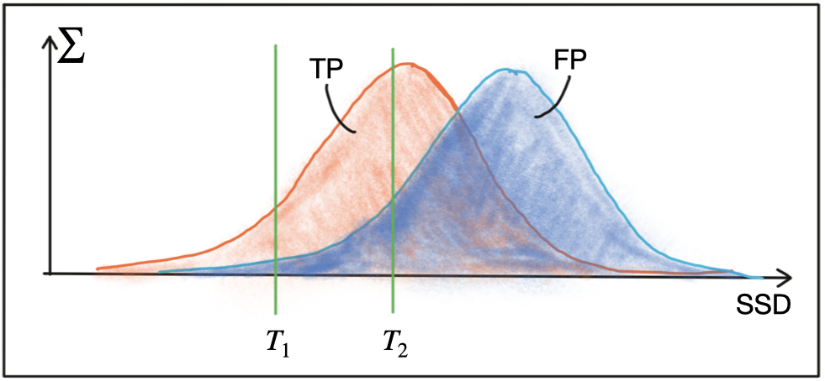
05. Descriptor Matching
you need to implement a suitable similarity measure so that your tracking algorithm can uniquely assign keypoint pairs.
Descriptor Matching
BFMatcher BruteForce
FLANN KD tree
Both BFMatching and FLANN accept a descriptor distance threshold T which is used to limit the number of matches to the ‘good’ ones and discard matches where the respective pairs are no correspondences.
In the case of a binary descriptor who consists only of ones and zeros, the best (and fastest) measure to use is the Hamming distance

Slide 34
05. Descriptor Matching (Selecting Matches)
For each descriptor in the source image, find one or more best matches in the reference image.
Switch the order of source and reference image.
Repeat the matching procedure between source and reference image from step 1.
Select those keypoint pairs whose descriptors are best matches in both directions.

Slide 35
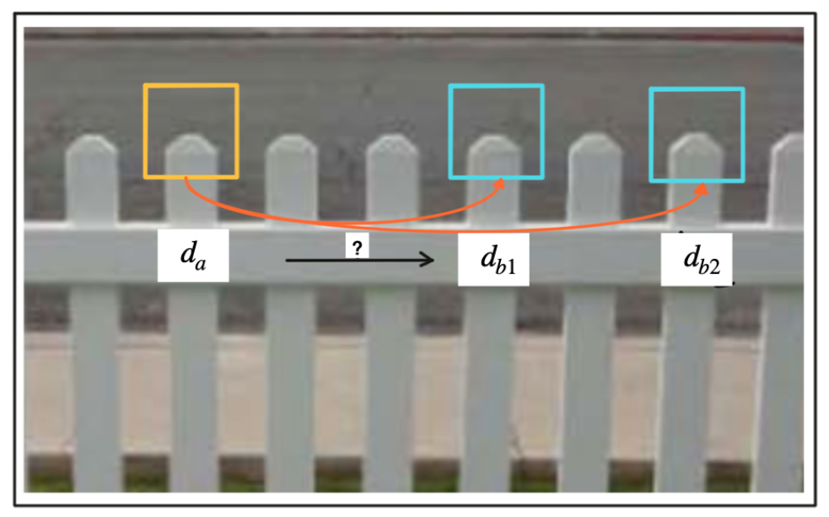
05. Descriptor Matching (Selecting Matches) K-Nearest Neighbor Algorithm
A very efficient way of lowering the number of false positives is to compute the nearest neighbor distance ratio for each keypoint. This method has been originally proposed by D. Lowe in the 1999 paper on SIFT. The main idea is to not apply the threshold on the SSD directly. Instead, for each keypoint in the source image, the two best matches are located in the reference image and the ratio between the descriptor distances is computed. Then, a threshold is applied to the ratio to sort out ambiguous matches. The figure below illustrates the principle.
Descriptors must be unique otherwise they are not Descriptors.
To lower number of descriptors, we choose descriptors in which the distance between 2 nearest matches is high whatever the distance between each of them to the ref. desc.
This what we called K-NN

Slide 36
Code descriptor_matching.cpp
Results:
BF matching cross-check=0 (NN) with n=100 matches in 8.10582 ms
Try other combinations

Slide 37
Time To Collusion Calculation
Camera – Lidar – Fusion

Slide 38
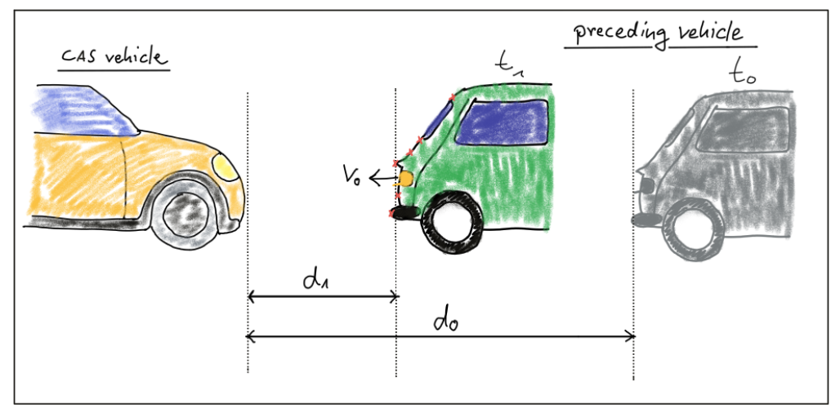
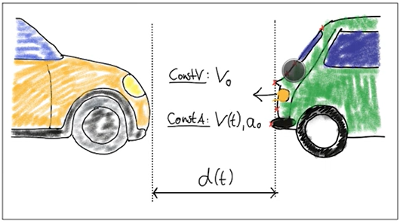
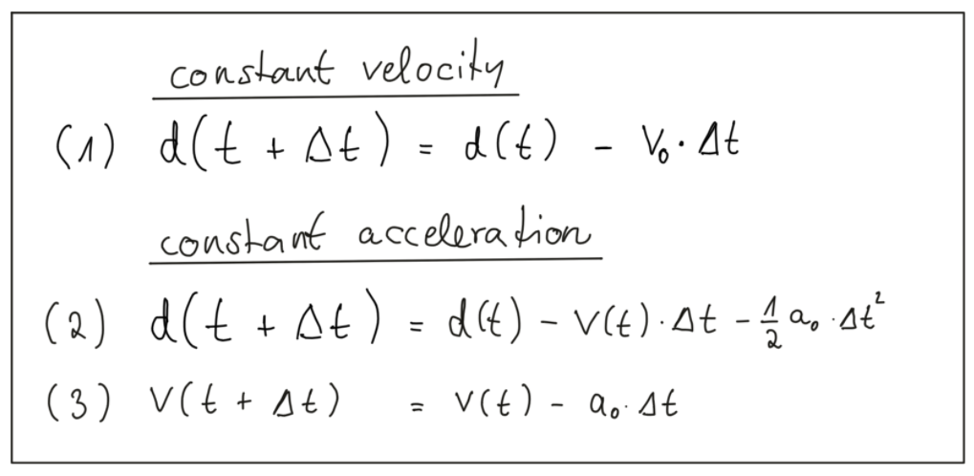
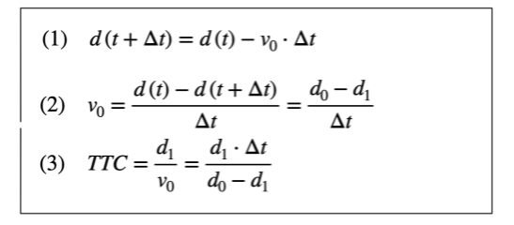
The Math Behind Time-to-Collision (TTC)
Motion Models

Slide 39
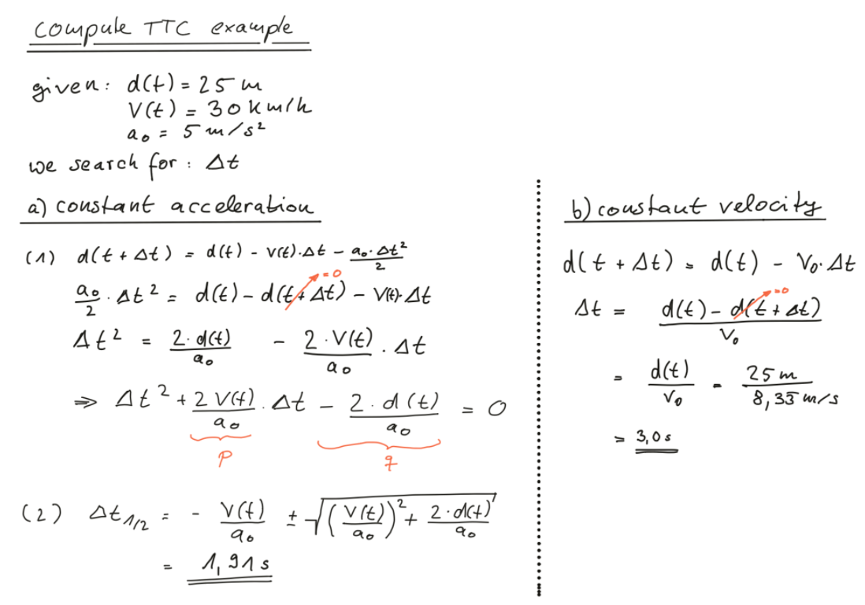

Slide 40
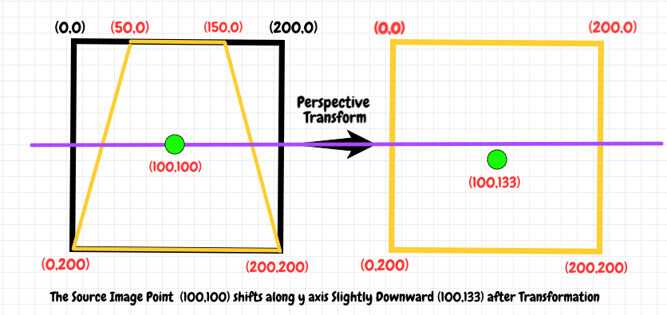
Measuring TTC without distance [Perspective Transform]

Slide 41
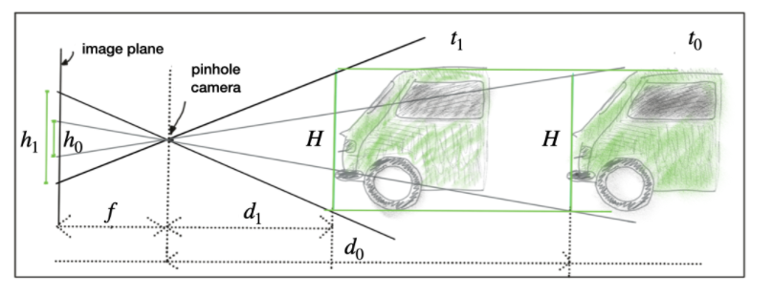
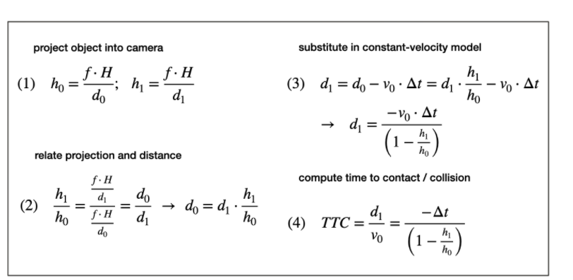
Measuring TTC without distance [Perspective Transform]

Slide 42
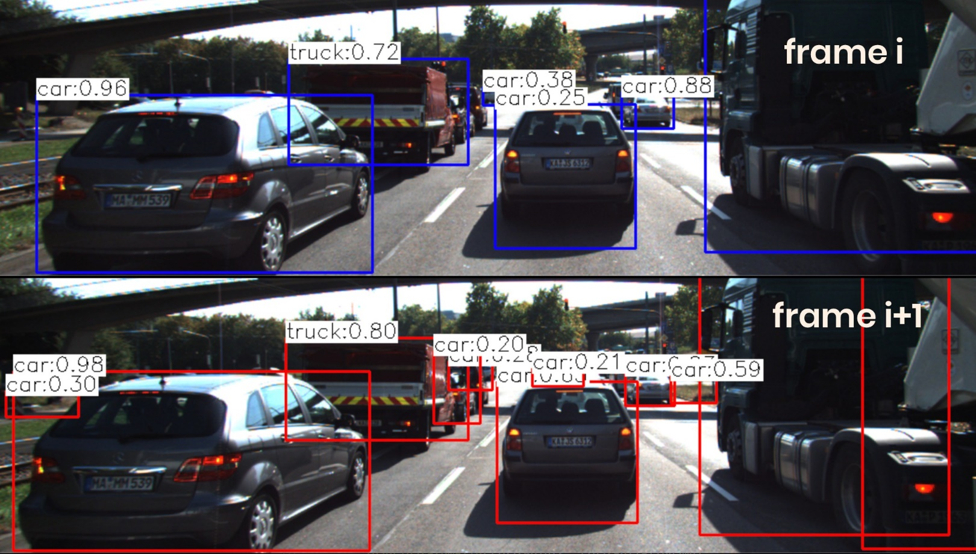
The Problem with Bounding Box Detection
In the figure below, a neural network has been used to locate vehicles in successive images of a monocular camera. For each vehicle, the network returns a bounding box, whose width and/or height could in principle be used to compute the height ratio in the TTC equation we derived in the last section.
When observed closely however, it can be seen that the bounding boxes do not always reflect the true vehicle dimensions and the aspect ratio differs between images. Using bounding box height or width for TTC computation would thus lead to significant estimation errors.

Slide 43
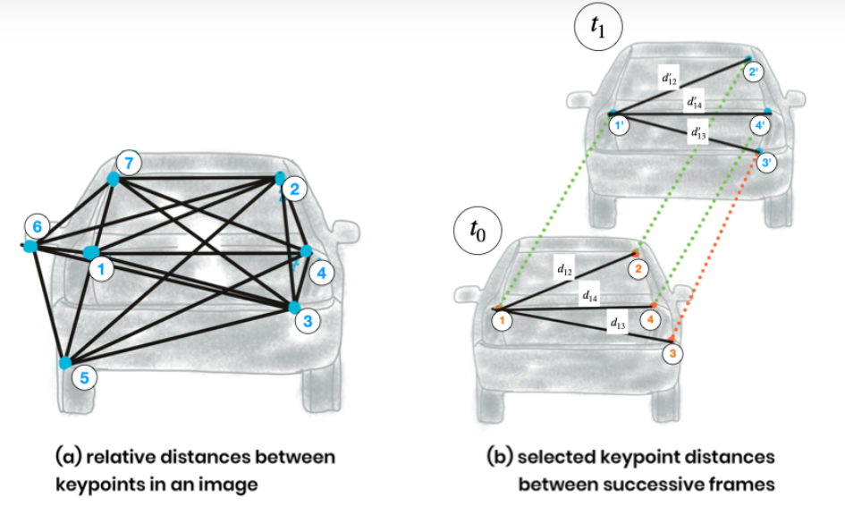
Using Texture Keypoints Instead
Instead of relying on the detection of the vehicle as a whole we now want to analyze its structure on a smaller scale. If it were possible to locate uniquely identifiable keypoints that could be tracked from one frame to the next, we could use the distance between all keypoints on the vehicle relative to each other to compute a robust estimate of the height ratio in out TTC equation. The following figure illustrates the concept.
In (a), a set of keypoints has been detected and the relative distances between keypoints 1-7 have been computed. In (b), 4 keypoints have been matched between successive images (with keypoint 3 being a mismatch) using a higher-dimensional similarity measure called descriptor (more about that in the next lesson). The ratio of all relative distances between each other can be used to compute a reliable TTC estimate by replacing the height ratio h1​/h0​ with the mean or median of all distance ratios dk​/dk′​.

Slide 44
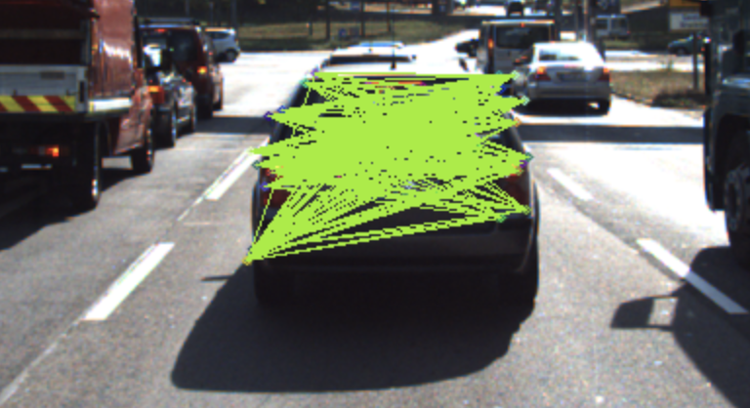
Using Texture Keypoints Instead
The following figure shows several examples of relative distances between keypoints as an overlay over a highway driving scene (only the preceding vehicle is highlighted).

Slide 45


*** Segmentation can be used!!!!!????

Slide 46
CODE
compute_ttc_camera.cpp
Result:
ttc = 12.4576s

Slide 47




The Math Behind Time-to-Collision (TTC)

Slide 48



Slide 49
CODE
compute_ttc_lidar.cpp
Result:
ttc = 12.9722s

Slide 50



Slide 51
Sheet 1

Slide 52


Slide 53


Slide 54


Slide 55


Slide 56


Slide 58
Lidar-Camera Fusion Block Diagram
Bounding Box with PCD
Lidar PCD
Filtering
Segmentation
Clustering
PCD Projection on Camera
Camera-lidar Fusion
Tracked ObjectList Class, Id Location(x,y,z) Velocity and Acc (Vx, Vy, Ax, Ay)
Features Extraction/Tracking
Objects Tracking
Bounding Boxes with Classes and Ids
Images
Image Processing
Objects Detection & Recognition

Slide 59








Lidar PCD projection on Image
SkyPCD Filtering
ProjectionMatrix
ProjOnImage
SimpleFiltering Vs RANSAC+Clustering
YOLO
Id,class
X,y,z
Width, Height
3D object Creation
Grouping Lidar points to object

Slide 60
Lidar PCD projection on Image

Slide 61

Lidar PCD projection on Image

Slide 62

Lidar PointCloud TopView
Try to filter roadcarpet simply

Slide 63

CODE
show_lidar_top_view.cpp
Change the color of the Lidar points such that X=0.0m corresponds to red while X=20.0m is shown as green with a gradual transition in between. The output of the Lidar point cloud should look like this:
imageWidth
x
xw
imageHeight
y
yw

Slide 64
CODE
show_lidar_top_view.cpp
Remove all Lidar points on the road surface while preserving measurements on the obstacles in the scene. Your final result should look something like this:
imageWidth
x
xw
imageHeight
y
yw

Slide 65


Camera Image Construction

Slide 66

Camera Image Construction
Pinhole image is inverted version of the reality

Slide 67


Camera Image Construction

Slide 68

Camera Image Construction

Slide 69

Intrinsic Parameters

Slide 70

Intrinsic Parameters

Slide 71

Extrinsic Parameters

Slide 72

Extrinsic Parameters

Slide 73



Extrinsic Parameters
(3*4)= (3*4) X (4*4)

Slide 74

Extrinsic Parameters

Slide 75


Projection Equation
(u,v)
Rectification
(3*1) = (3*3) X (3*3) X (3*3) X (3*4) X (4*4) X (4*1)
(3*1) = (3*3) X (3*3) X (3*4) X (4*1)

Slide 76
Projection Equation (Version2) (used in code)
0
0
0
0
0
0
0 0 0 1
0 0 0 1
(u,v)
Rectification
0 0 0 1
(3*1) = (3*3) X (3*4) X (4*4) X (4*4) X (4*4) X (4*1)
(3*1) = (3*4) X (4*4) X (4*4) X (4*1)

Slide 77


KITTI Example

Slide 78
CODE
project_lidar_to_camera.cpp
Overlay:
Sky must be neglected as it cause errors

Slide 79
CODE
project_lidar_to_camera.cpp
Final Output after projection:
Sky projection/alignment with camera must be neglected as it cause errors

Slide 80
CODE
filter_lidar_points.cpp
maxX = 25.0
maxY = 6.0
minZ = -1.4

Slide 81

Why Object Detection
we need a way to detect vehicles in our images so that we can isolate matched keypoints as well as projected Lidar points and associate them to a specific object.

Slide 82

Object Detection using YOLO

Slide 83
Object Detection using YOLO
The YOLOv3 Workflow
In this section, we will take a look at the different steps involved to execute YOLO on the course image set. The parameters used below are mainly the ones suggested by the authors. In the following, a short overview of the main algorithmic steps is given:
First, the image is divided into a 13x13 grid of cells. Based on the size of the input image, the size of these cells in pixels varies. In the code below, a size of 416 x 416 pixels was used, leading to a cell size of 32 x 32 pixels. As seen in the schematic above, each cell is then used for predicting a set of bounding boxes.
507 (Network0_BoundingBoxes) = 13*13*3
2028 (Network1_BoundingBoxes) = 13*13*12
8112 (Network2_BoundingBoxes) = 13*13*48
For each bounding box, the network also predicts the confidence that the bounding box encloses a particular object as well as the probability of the object belonging to a particular class (taken from the COCO dataset (80 class)).
Lastly, a non-maximum suppression is used to eliminate bounding boxes with a low confidence level as well as redundant bounding boxes enclosing the same object.

Slide 84

CODE
detect_objects_2.cpp

Slide 85

Grouping Lidar Points
Why is this section important for you?
In this last section before the final project, you will learn how to combine 2D image features, 3D Lidar points, and 2D YOLO-based vehicle bounding boxes to produce a stable 3D trajectory of a preceding vehicle. This will be the basis for creating a robust implementation of the TTC algorithm you have already learned about in a previous lesson.
Grouping (Associating) Lidar Points Using a Region of Interest

Slide 86

Grouping Lidar Points
Bounding Box Strucure

Slide 87

Grouping Lidar Points
Shrinking Region of Interest
In some cases, object detection returns ROI that are too large and thus overlap into parts of the scene that are not a part of the enclosed object (e.g. a neighboring vehicle or the road surface).
It is therefore advisable to adjust the size of the ROI slightly so that the number of Lidar points which are not physically located on the object is reduced. The following code shows how this can be achieved without much effort.

Slide 88
Grouping Lidar Points
Shrinking Region of Interest
The figure below shows two different settings for "shrinkFactor".
It can be seen that for the second figure, the projected Lidar points are concentrated on the central area of the preceding vehicle whereas Lidar points close to the edges are ignored.

Slide 89

Grouping Lidar Points
Avoiding Grouping Errors
Counting no. of ROIs in which the lidar point is enclosed, if (>1) neglect lidar point

Slide 90





CODE
cluster_with_roi.cpp
Avoiding Grouping Errors

Slide 91
Creating 3D Objects
distance to the closest point in x-direction
object width and height
number of supporting Lidar points

Slide 92
Final Project Track an Object in 3D Space
Check the project rubric to ensure that all criteria are met.

